Slide 1

R Programming – Arrays and Matrixes
Ivo Bernardo – Udemy Course

Slide 2
Arrays
Arrays are R objects that are able to store data in multiple dimensions.
example_array = array(data=c(1,2,3), dim=c(1,2,2))
Characteristics:
They take vectors as input.
The dim argument controls the dimension of the vector.
With c(1,2,2) we create 2 matrixes with 1 row by 2 columns.
Every position in the dim corresponds to it’s dimension.
You can use dimnames to name elements in the array.
They hold elements of the same type.

Slide 3
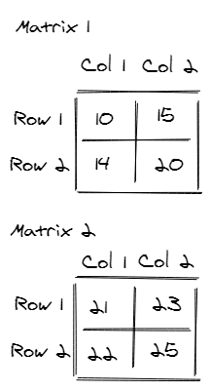
example_array = array(
data=c(10,14,15,20,21,22,23,25),
dim=c(2,2,2),
dimnames = list(c('Row 1','Row 2'),
c('Col 1', 'Col 2'),
c('Matrix 1', 'Matrix 2'))
)

Slide 4
Indexing Arrays
We can index arrays by the names of the dimension:
example_array['Row 1','Col 1','Matrix 1']
example_array[, ,'Matrix 2']
Or by position:
example_array[1,1,1]
example_array[ , ,2]

Slide 5
Matrixes
Matrixes are special types of 2 dimensional arrays – they are indexed the same way. You can create one with both of these commands:
example_matrix = array(data=c(1,2,3,4), dim=c(2,2))
example_matrix = matrix(data=c(1,2,3,4), nrow=2, ncol=2)
Characteristics:
They take vectors as input.
The nrow and ncol control the number of elements in the first and second dimension (rows and columns).
You can use dimnames to name elements in the array.
They hold elements of the same type.

Slide 6
Indexing Matrixes
We can index matrixes by the names of the dimension:
example_matrix['Row 1','Col 1']
example_array[‘Row 1’, ]
Or by position:
example_array[1,1]
example_array[1,]

